Slide 1
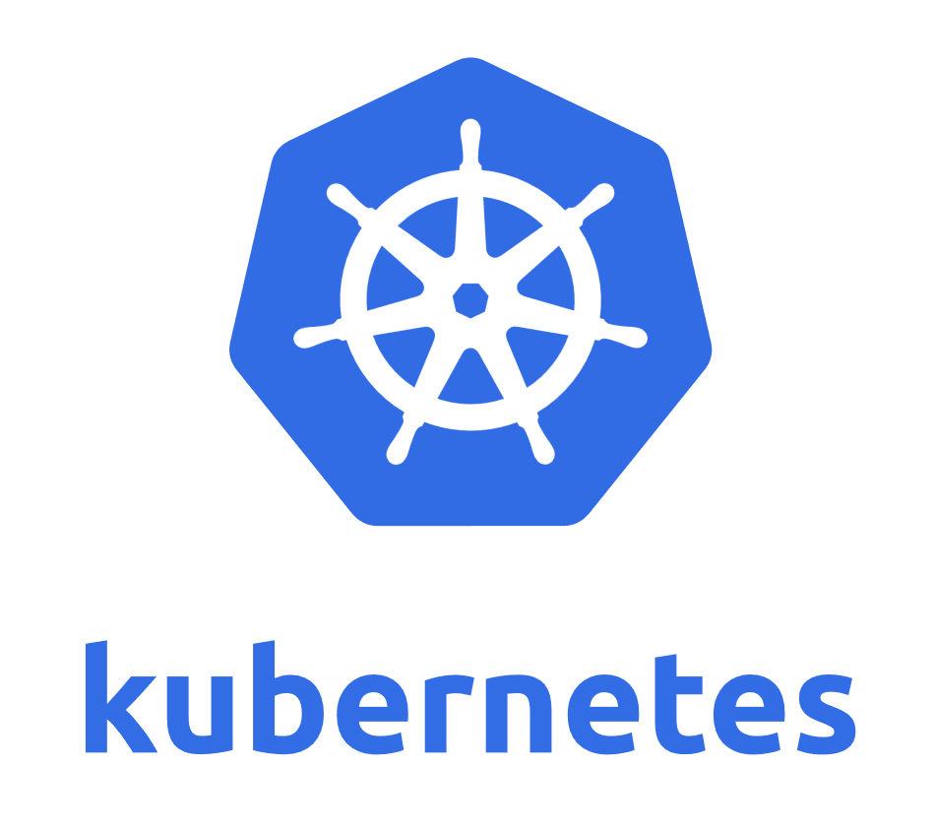
Setting up Kubernetes (minikube)
Kubernetes, also known as k8s, is an open-source system for automating deployment, scaling, and management of containerized applications. It is a portable, extensible open-source platform for managing containerized workloads and services, that facilitates both declarative configuration and automation, letting us run distributed systems resiliently, with scaling and failover for our application.
Minikube is a tool that lets us run kubernetes locally. Minikube runs a single-node kubernetes cluster on our personal computer so that we can try out kubernetes, or for daily development work. It quickly sets up a local Kubernetes cluster on macOS, Linux, and Windows.

Slide 2
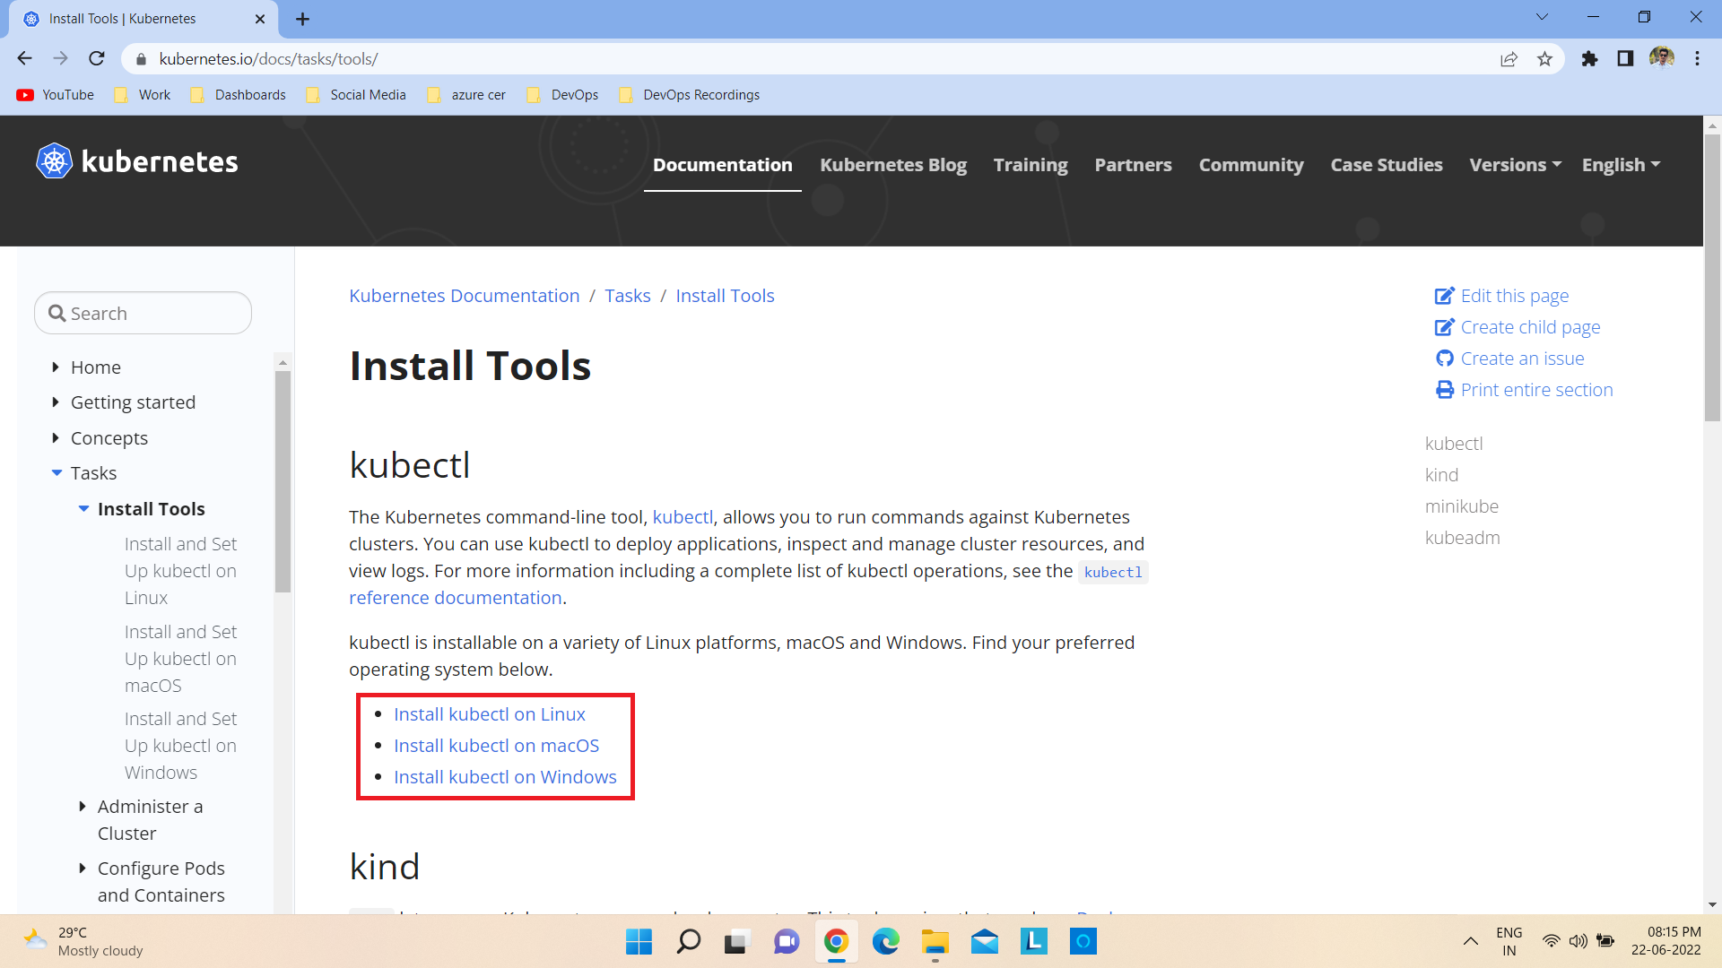
Steps for installation—
1) Go to https://kubernetes.io/docs/tasks/tools/

Slide 3
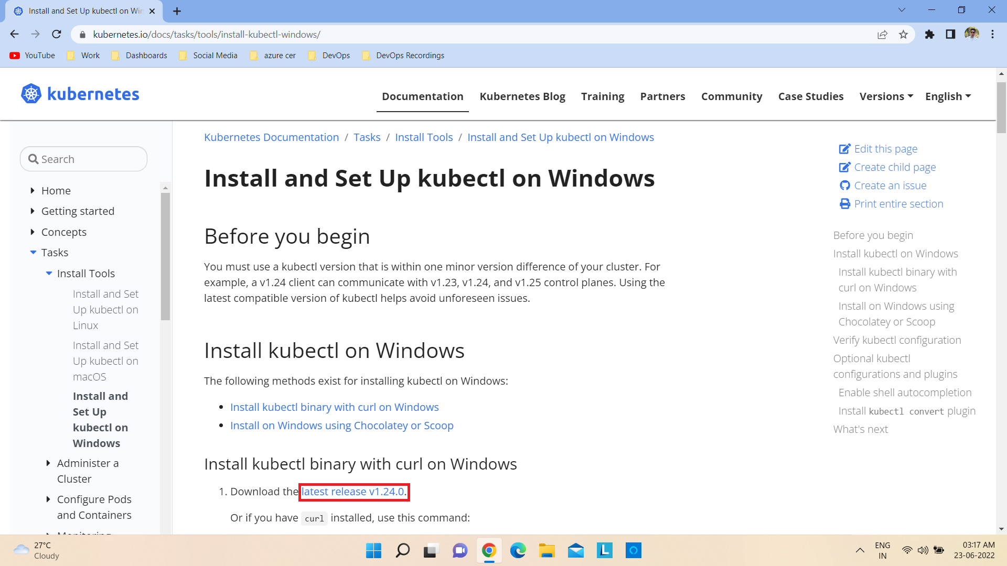
2) Click on latest release v1.24.0 to download the application

Slide 4
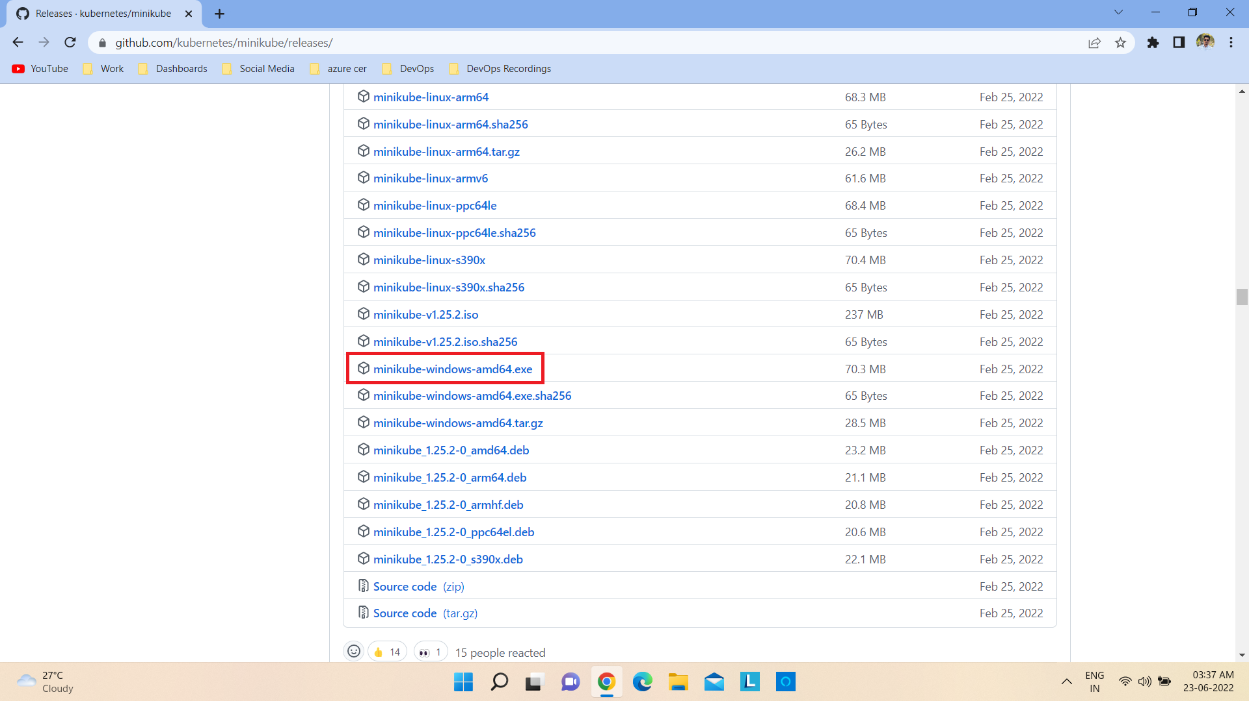
3) Go to https://github.com/kubernetes/minikube/releases/ and click on minikube-windows-amd64.exe to download the minikube application.

Slide 5
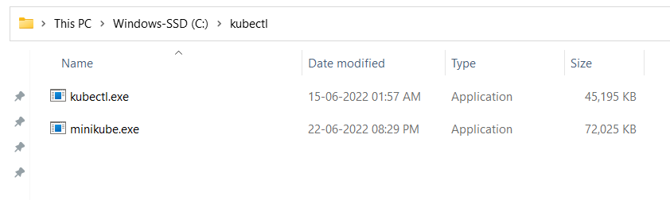
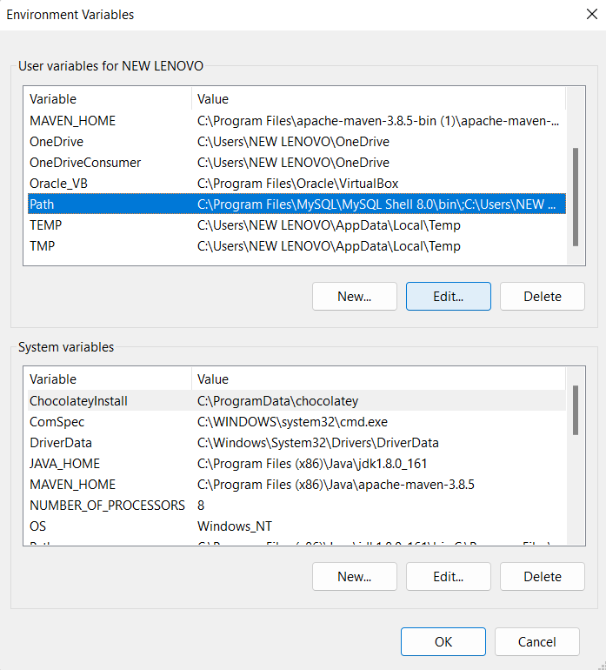
4) Go to the Download folder and copy/cut the kubectl application and minikube application, and paste it in a folder of any name.
5) Go to Environment Variables and select Path and then click on Edit.

Slide 6
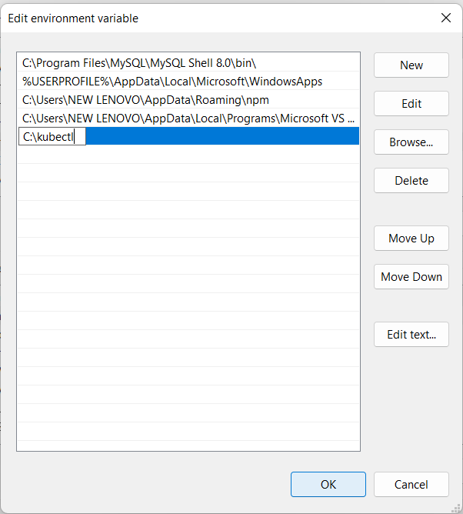
6) Click on New and paste the path of the folder which contains the kubectl and minikube applications and then click on OK.

Slide 7
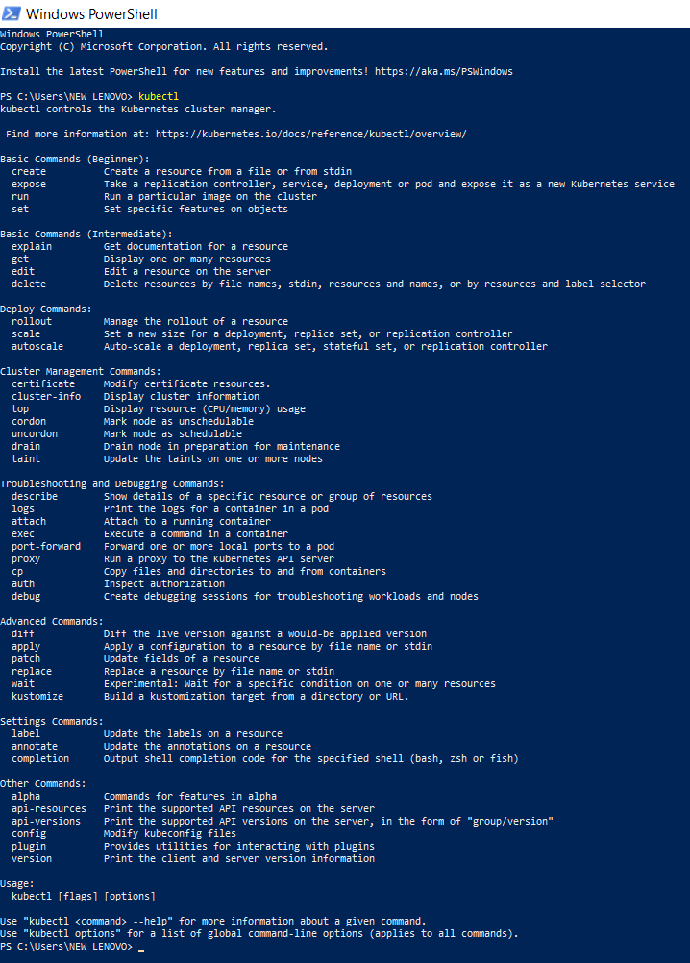
7) Open Windows PowerShell and type kubectl and press Enter to check whether kubectl is installed or not.

Slide 8
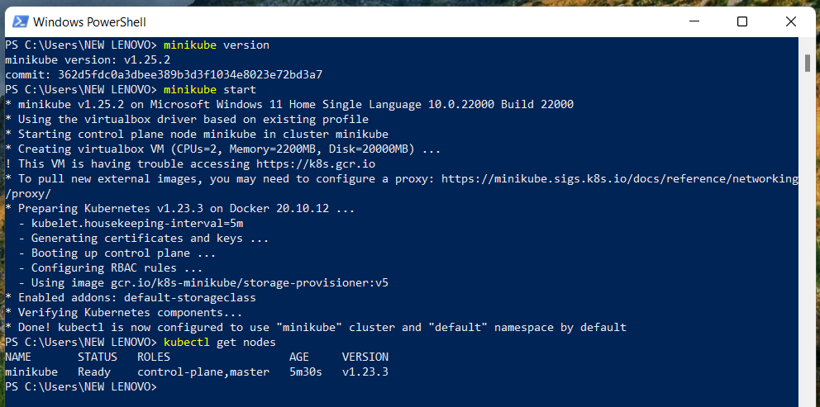
8) Open Windows PowerShell and type minikube version and press Enter to check whether minikube is installed or not.
9) Type minikube start and press Enter to start minikube.
10) Type kubectl get nodes and press Enter to check whether minikube is ready.

Slide 9
Thank you !

